Slide 1
High Waters Need Strong Bridges

Slide 2
Galveston, 1900

Slide 3
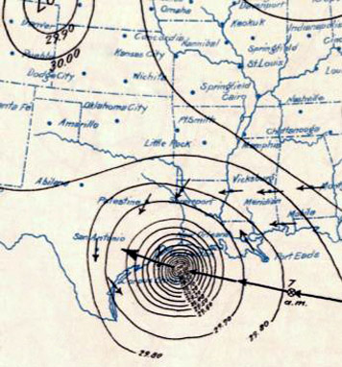
Surface Weather Analysis of the Hurricane on September 8, Just before Landfall
NOAA

Slide 4
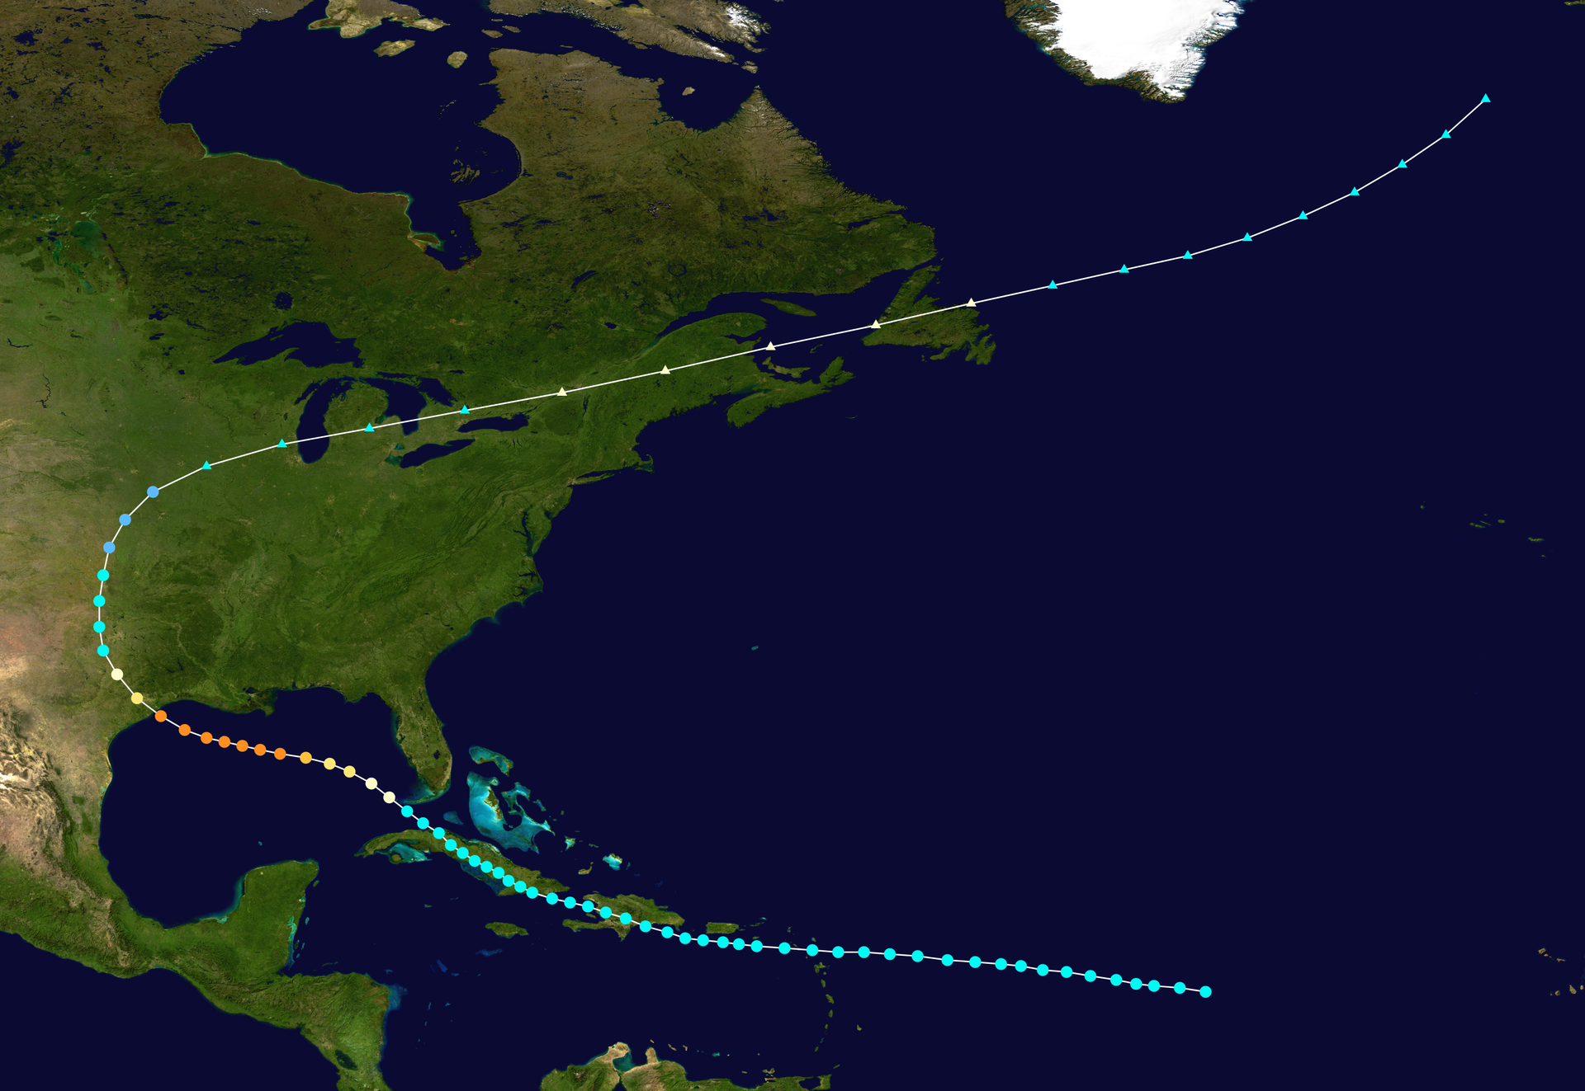

Slide 5
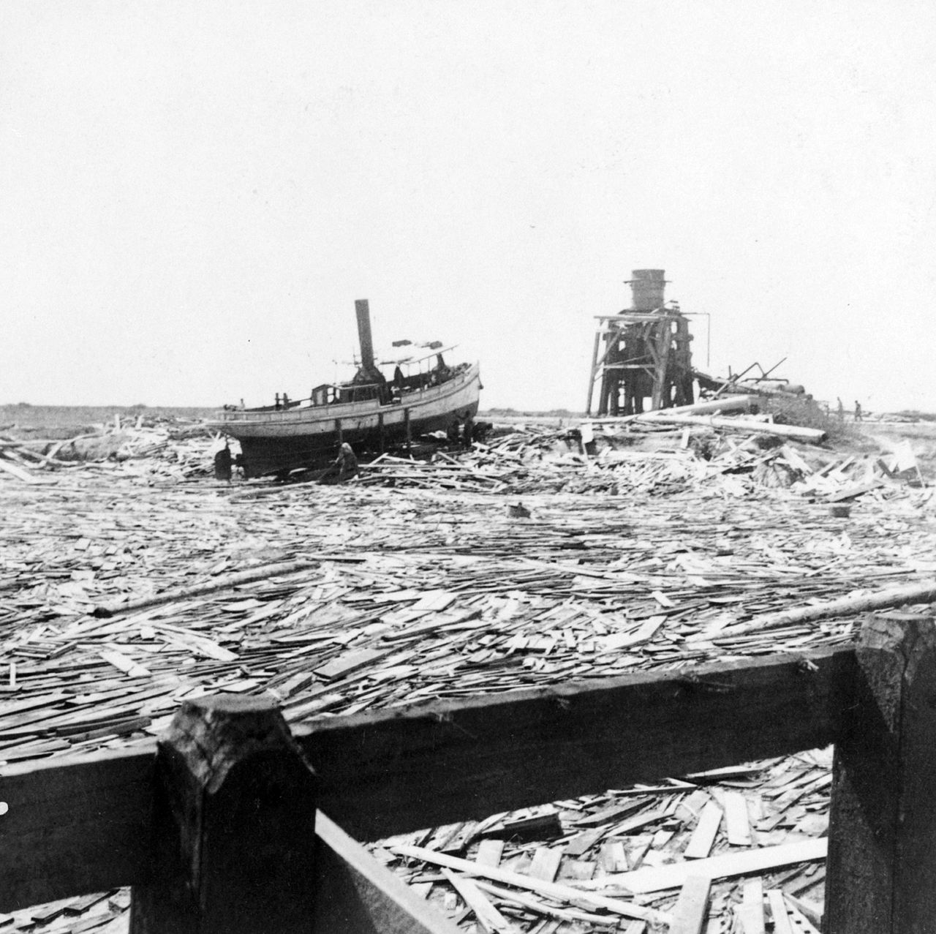
Near Texas City
Library of Congress

Slide 6
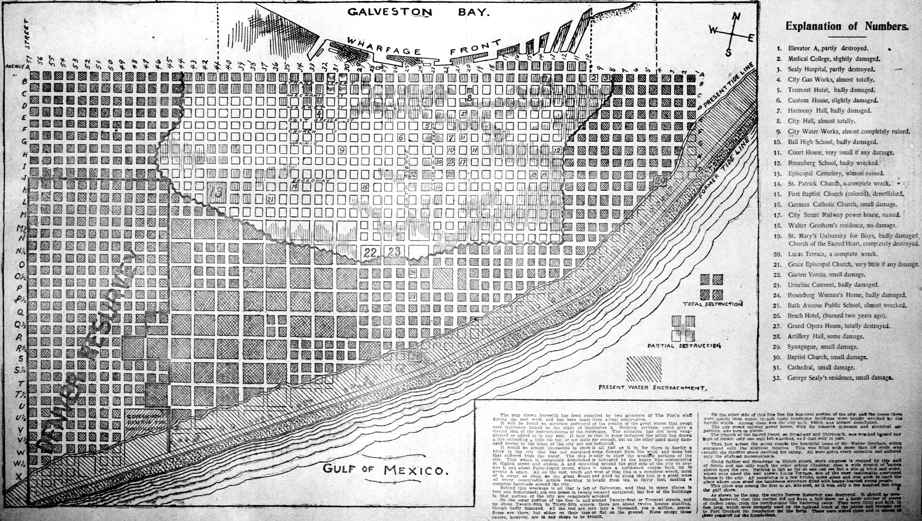
The Houston Post on September 27, 1900

Slide 7
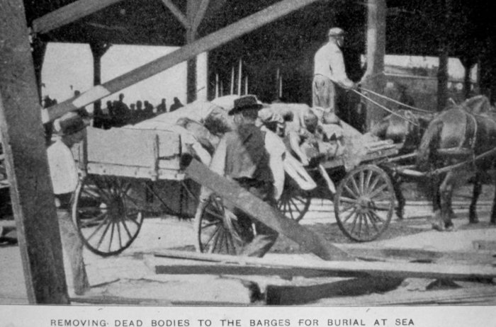
NOAA

Slide 8
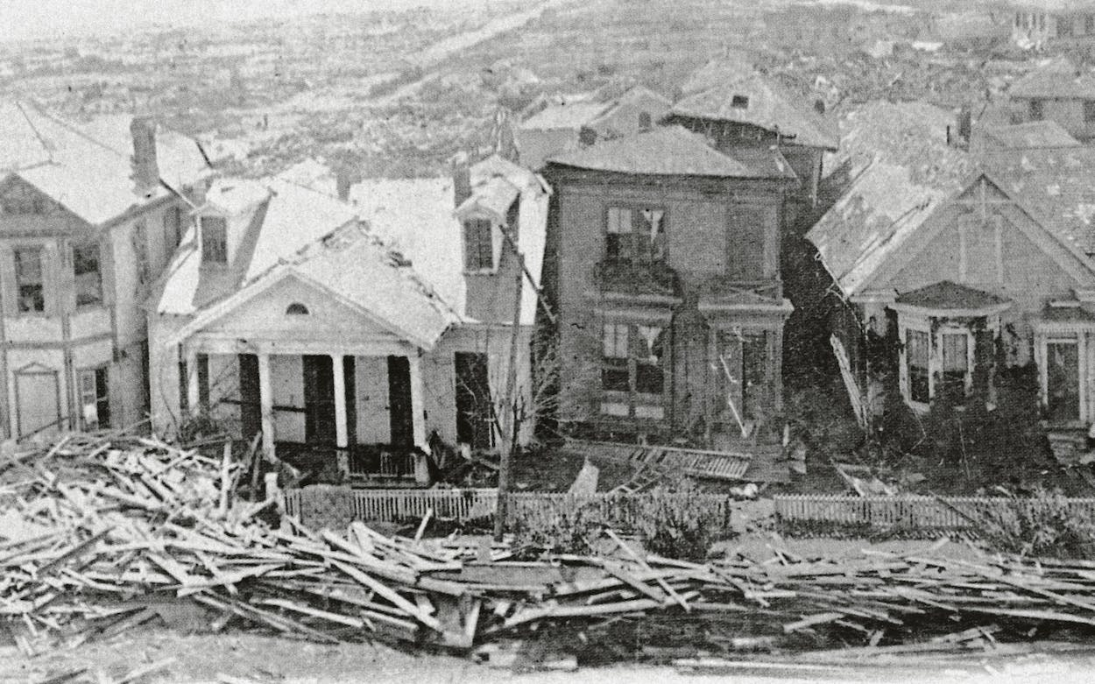
Rosenberg Library, Galveston

Slide 9
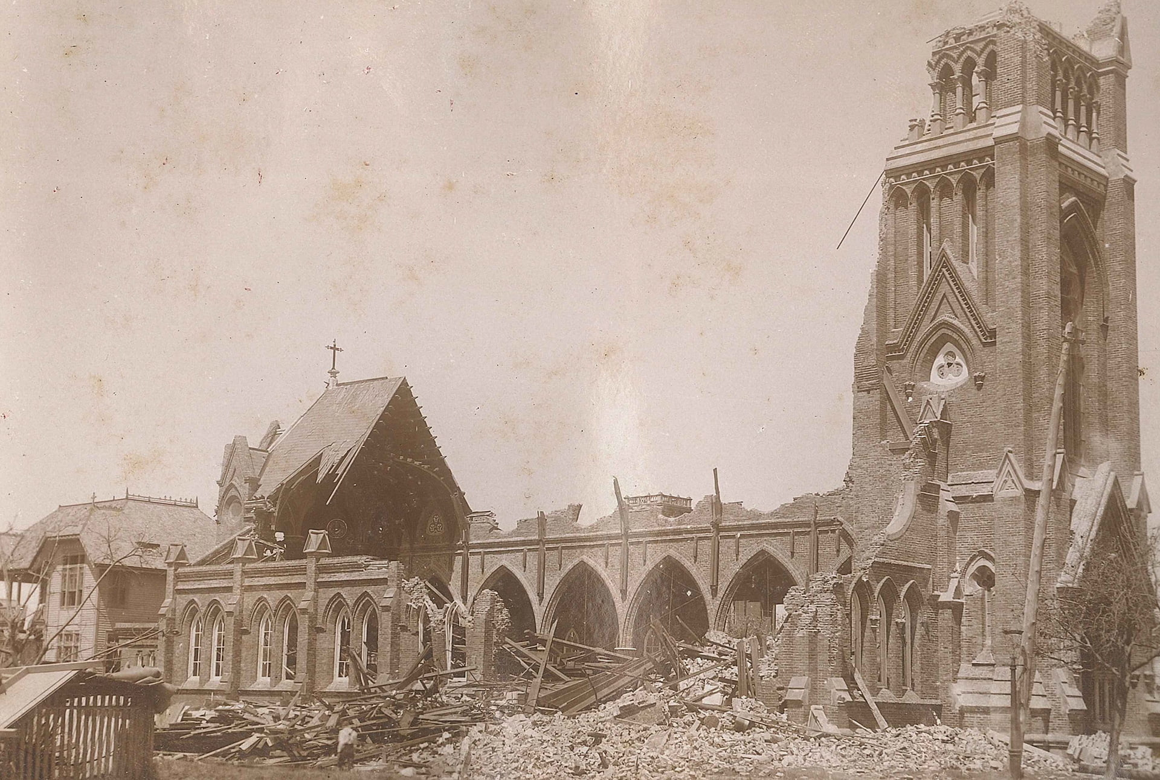

Slide 10
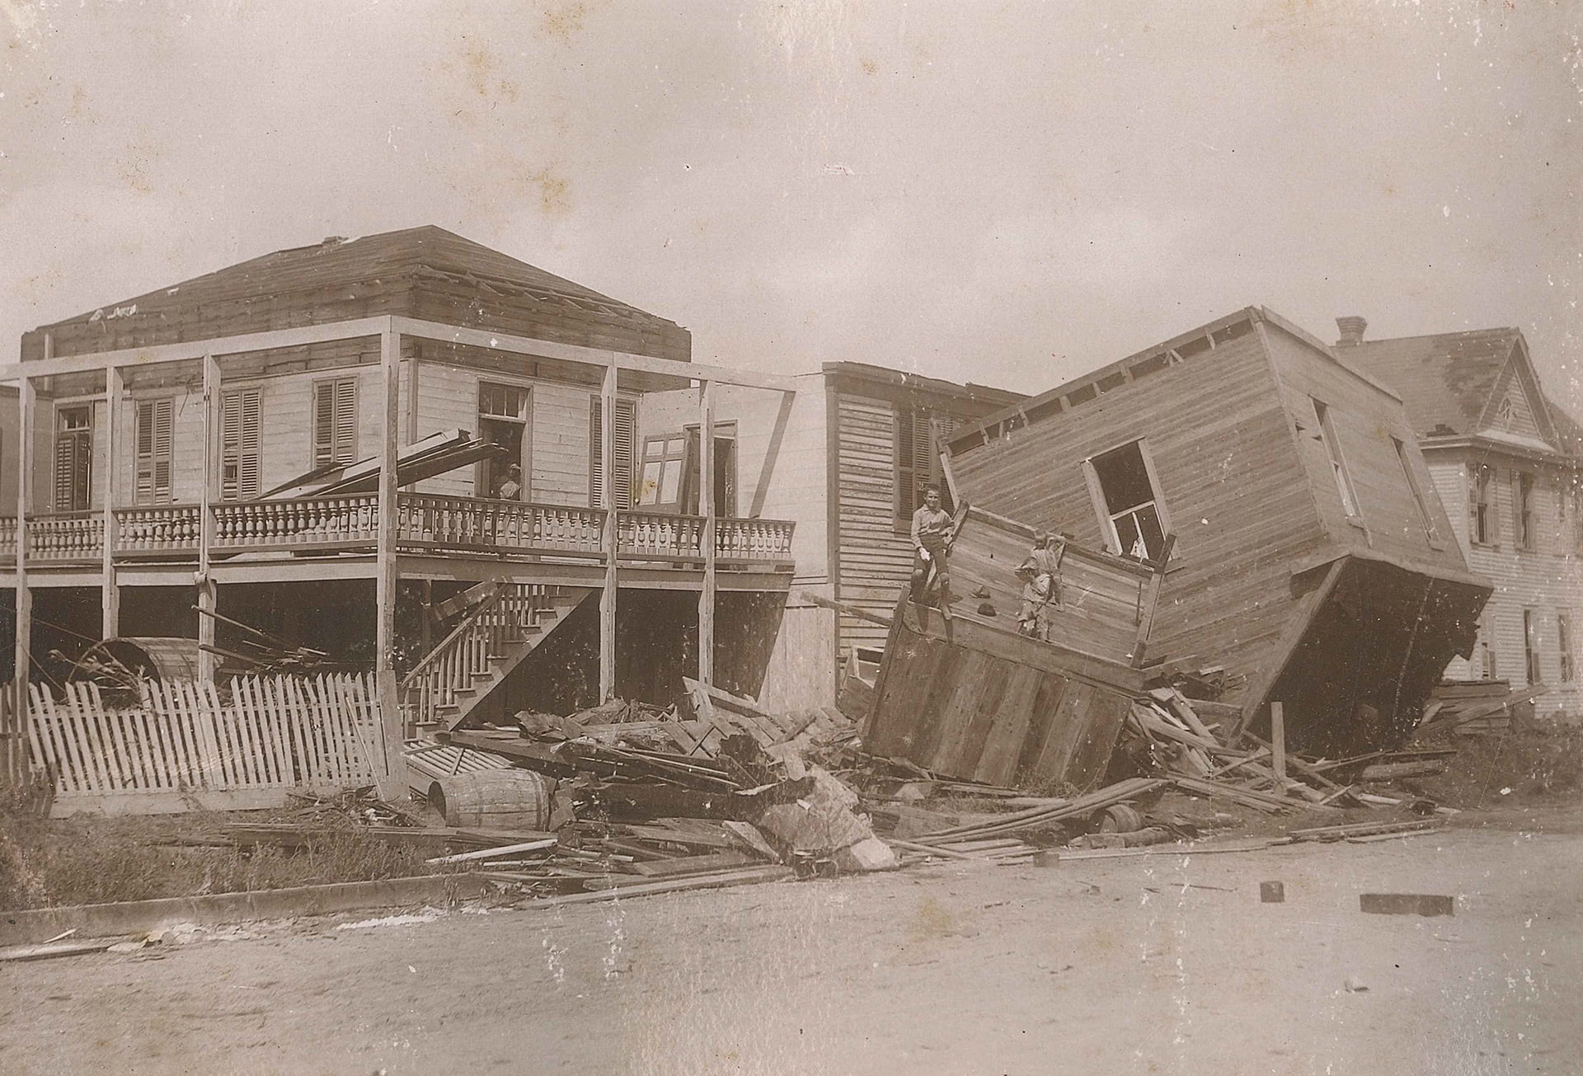

Slide 11
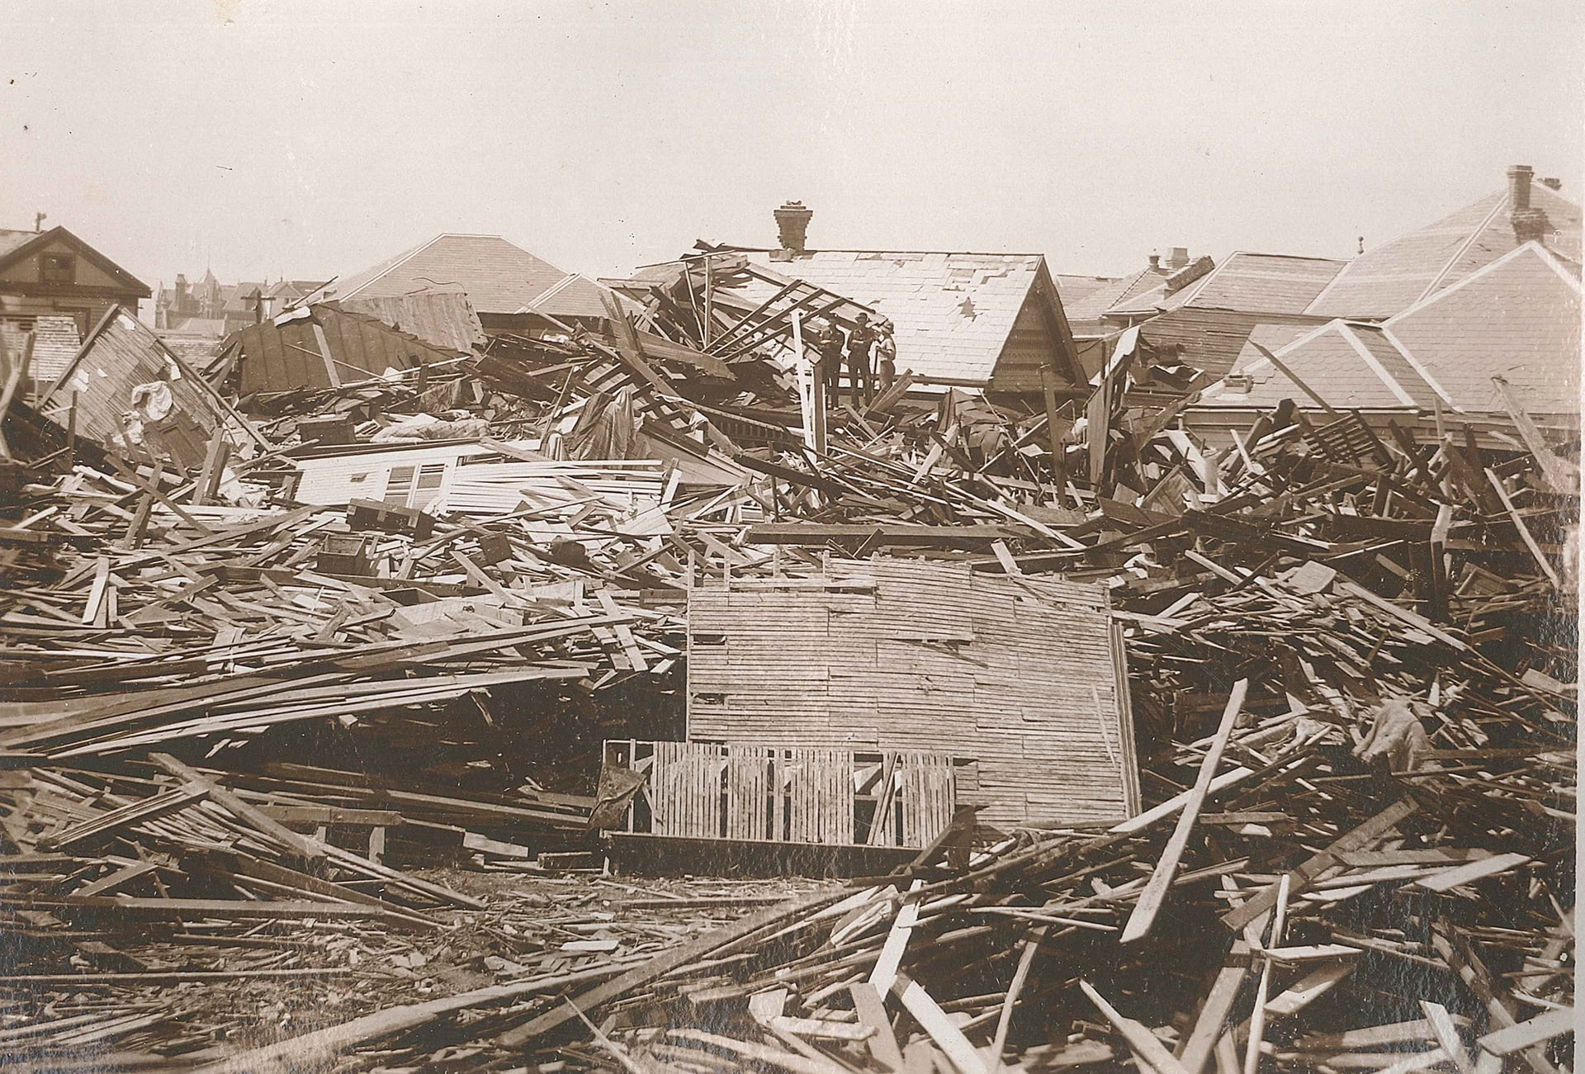

Slide 12
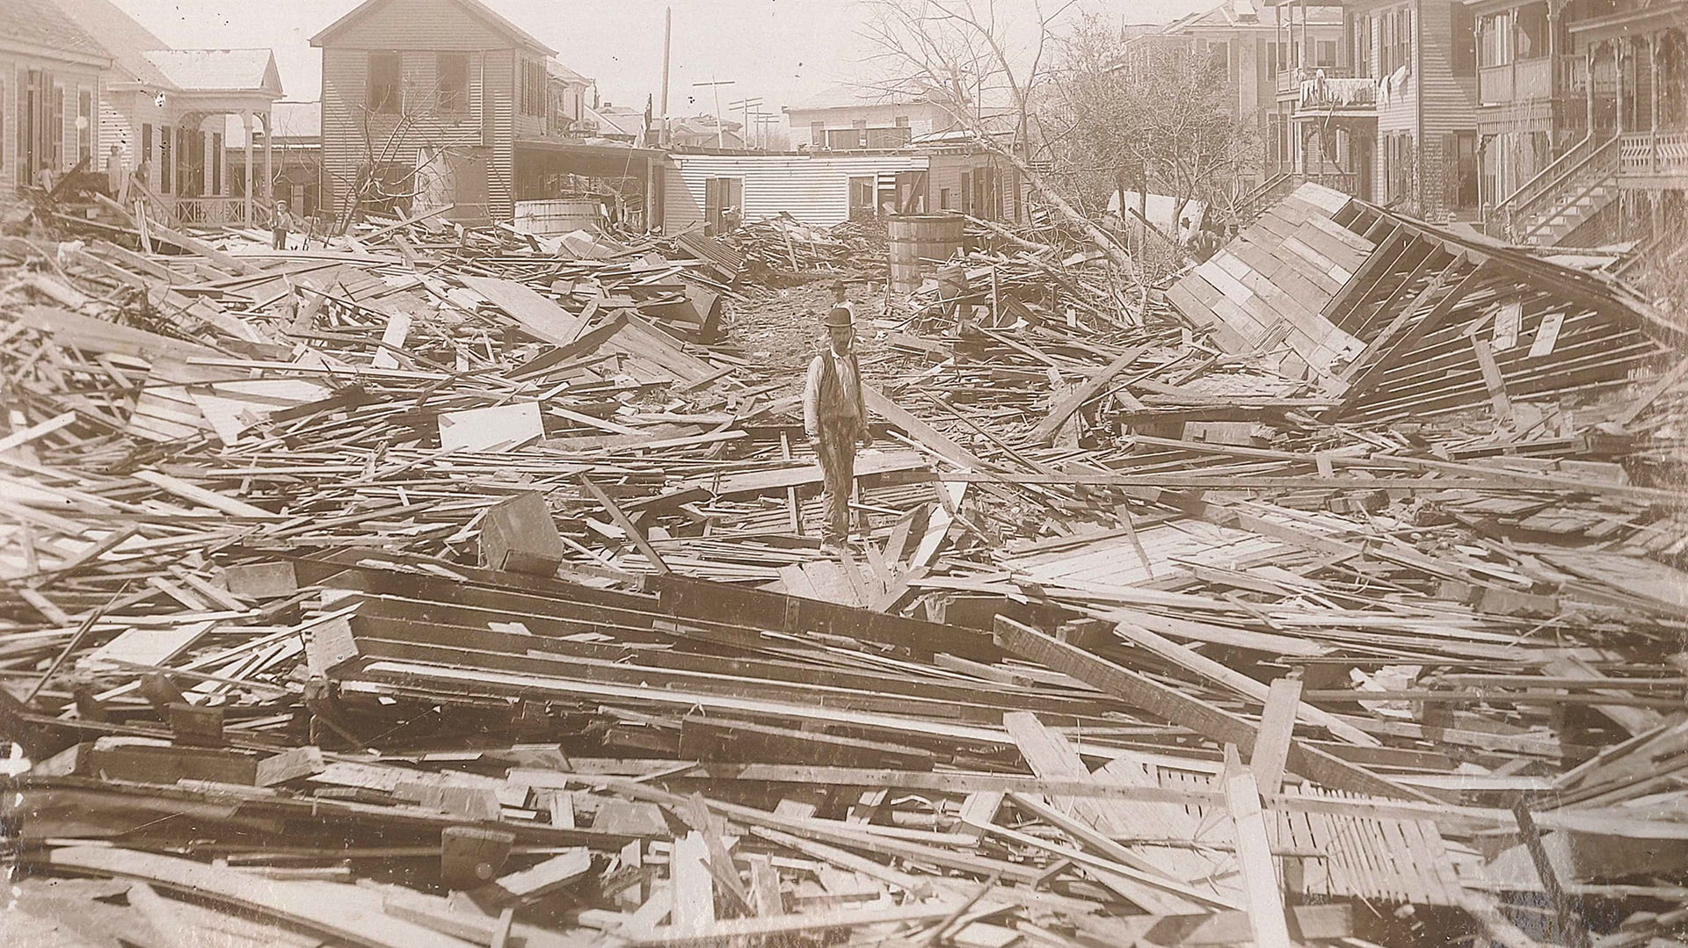

Slide 13
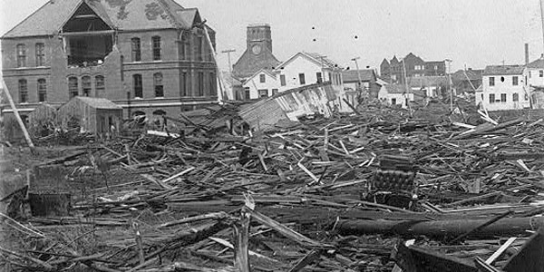
NOAA

Slide 14
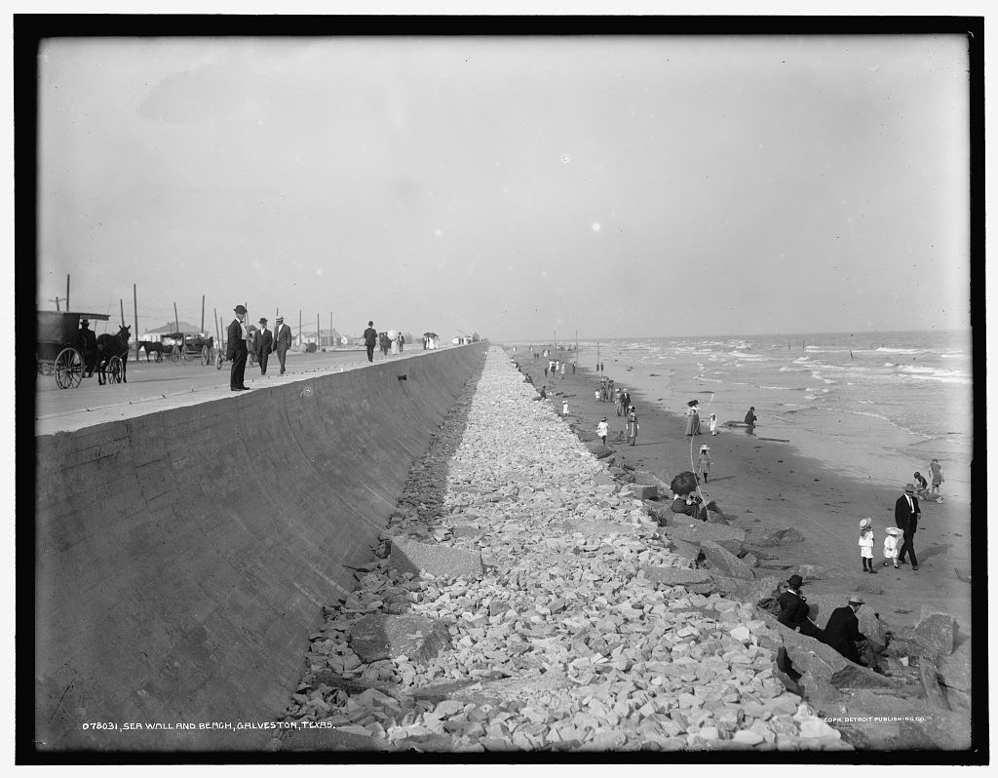

Slide 15
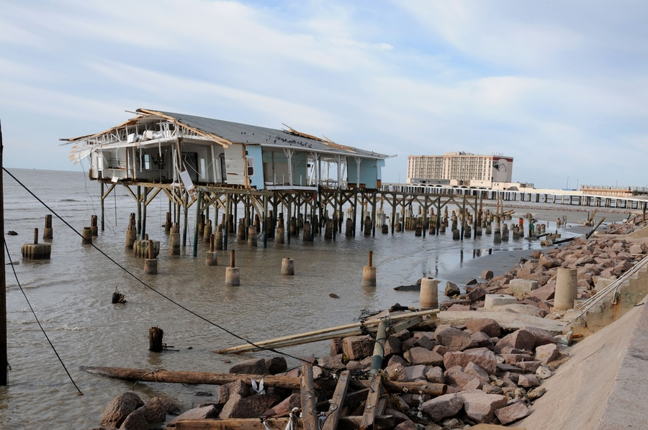
Hurricane Ike, 2008

Slide 16
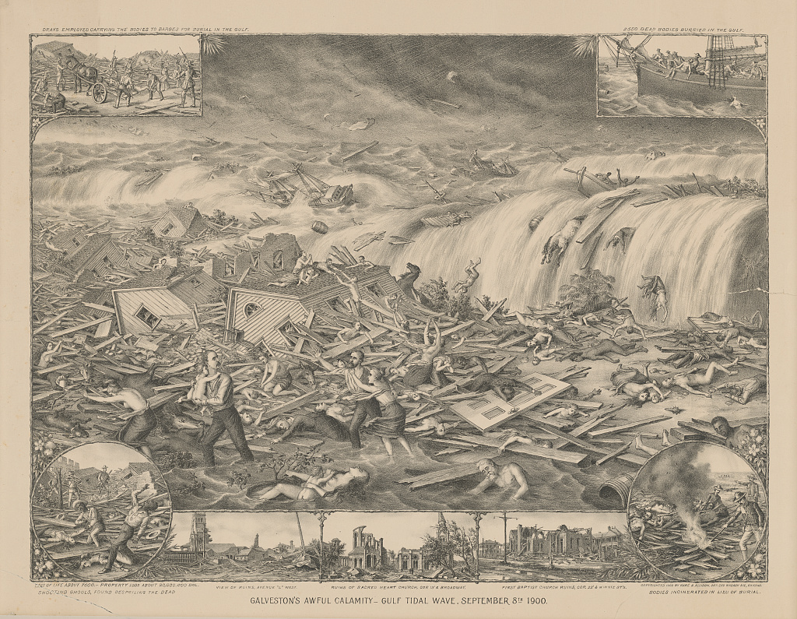
Galveston's awful calamity - Gulf tidal wave, September 8th 1900
Kurz & Allison
”Print shows the destruction caused by a hurricane and tidal wave to Galveston, Texas, wreckage to buildings, survivors, and the bodies of victims; also shows vignettes at the corners and across the bottom: Drays employed carrying the bodies to barges for burial in the Gulf (top left), 2650 dead bodies burried [sic] in the Gulf (top right), Bodies incinerated in lieu of burial (bottom right), Shooting ghouls, found despoiling the dead (bottom left), and at center, View of ruins, Avenue "L" west, Ruins of Sacred Heart Church, cor 13' & Broadway, and First Baptist Church ruins, cor. 22' & Winnie st’s.”

Slide 17
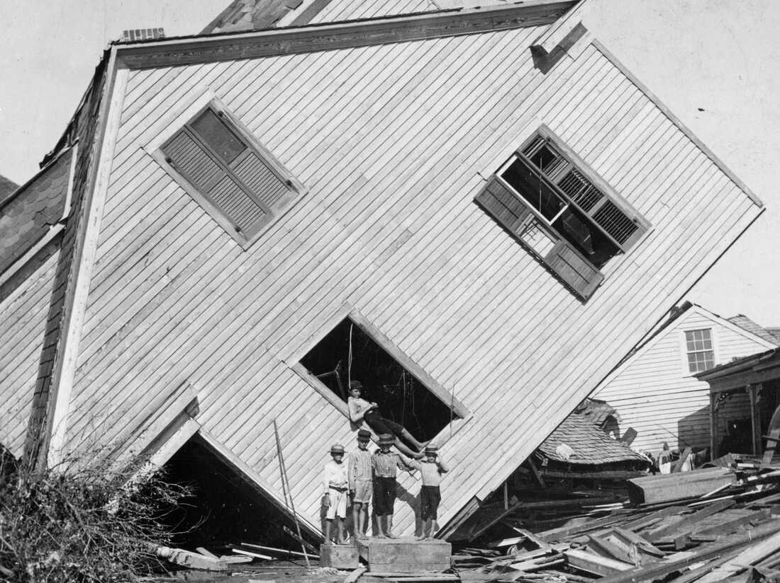
Library of Congress

Slide 18
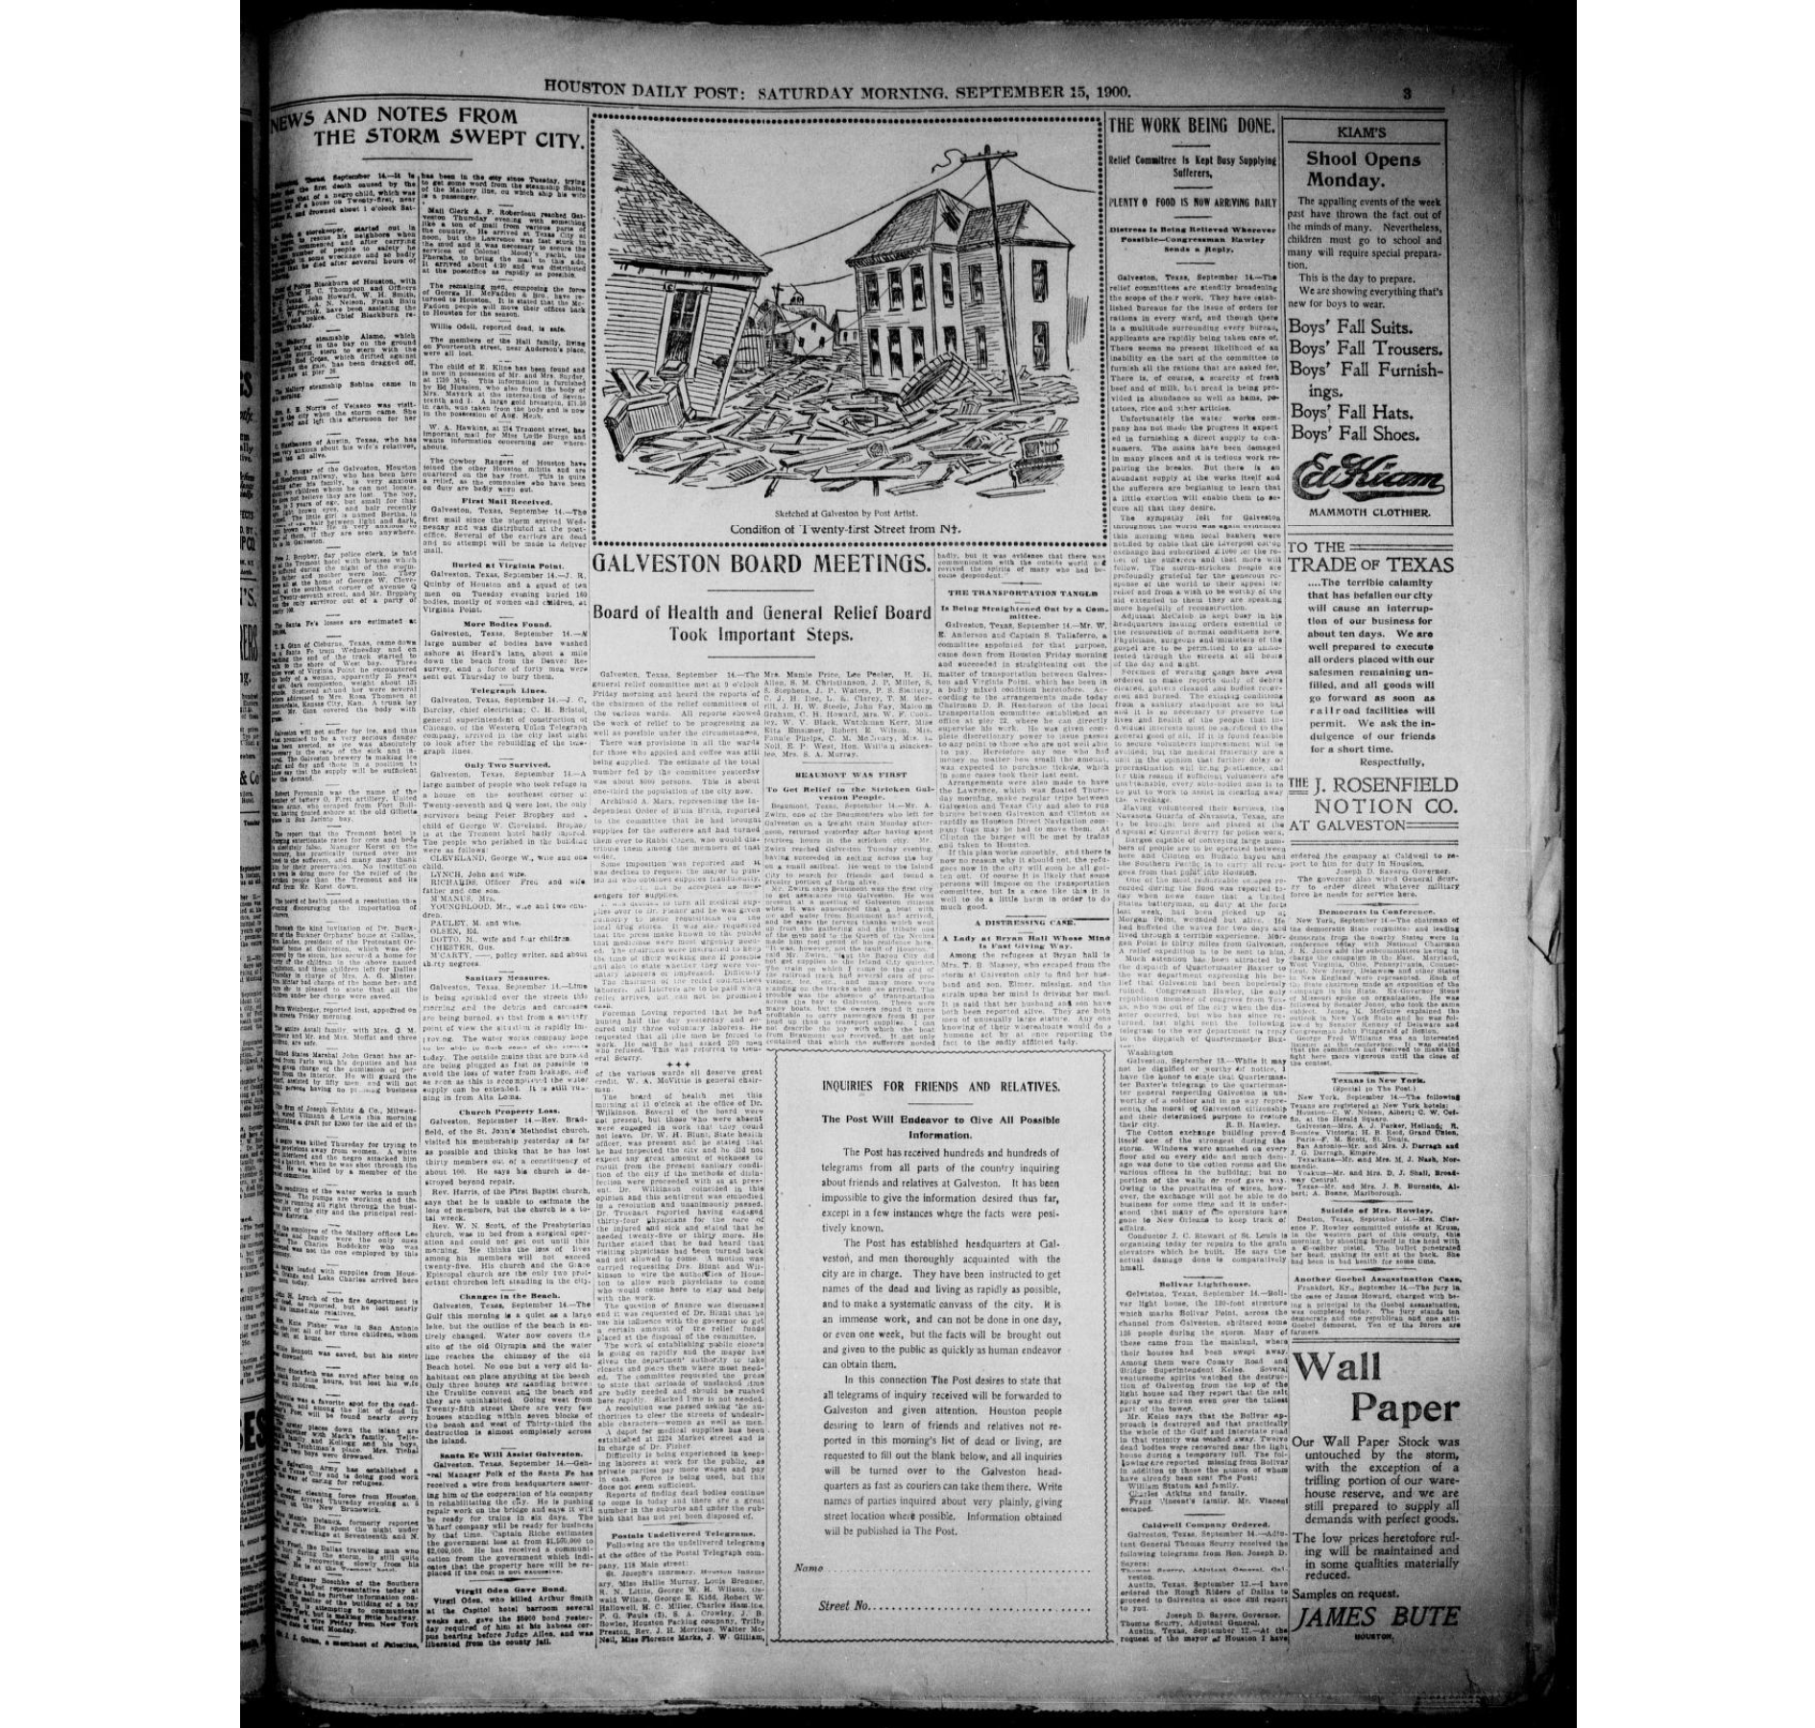
The Houston Daily Post. September 15, 1900

Slide 19
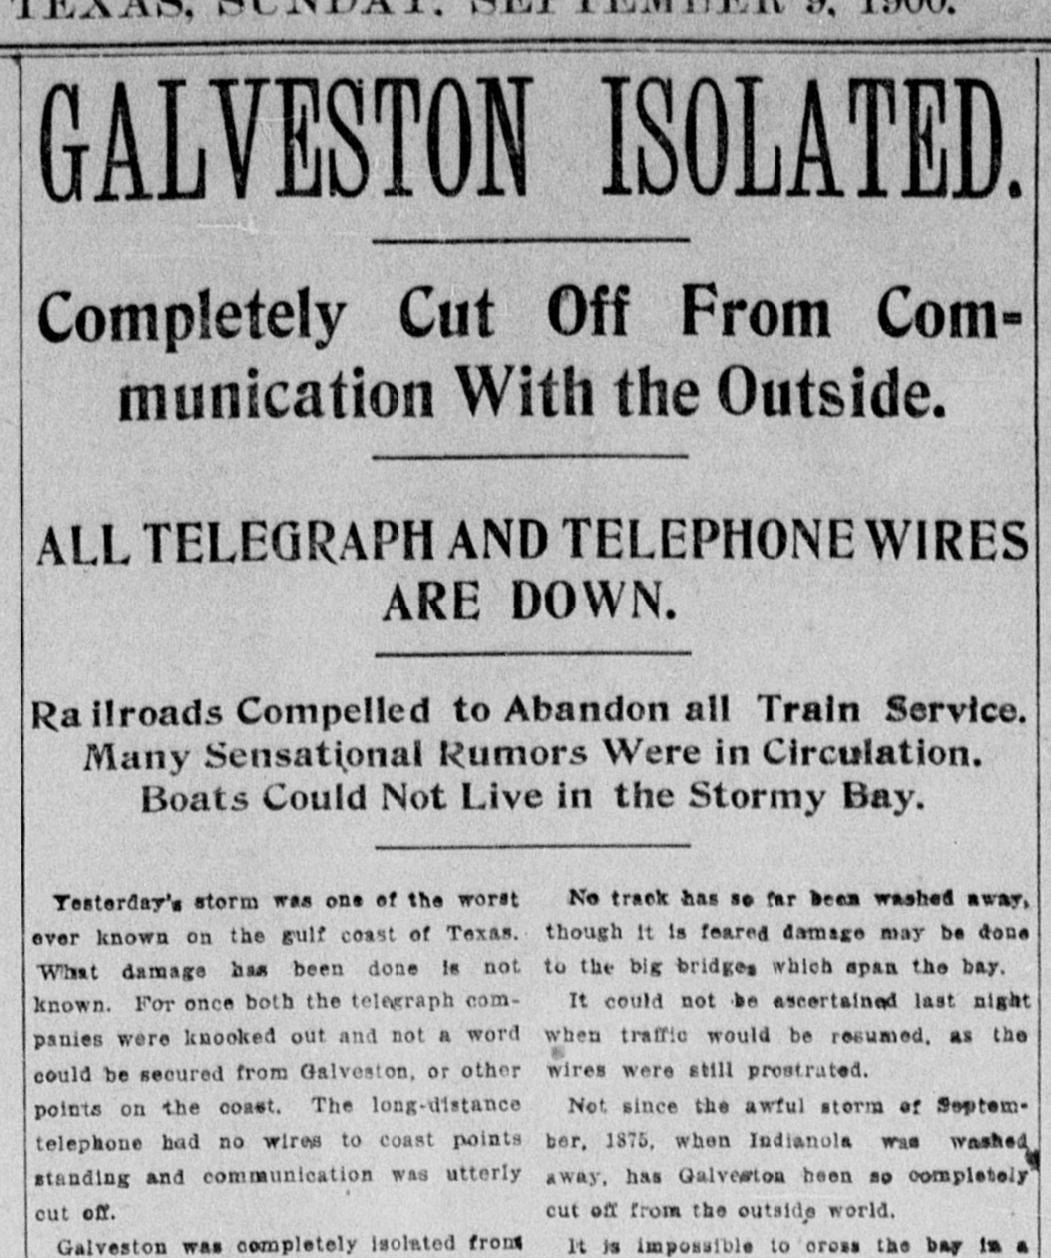
The Houston Daily Post. September 9, 1900

Slide 20
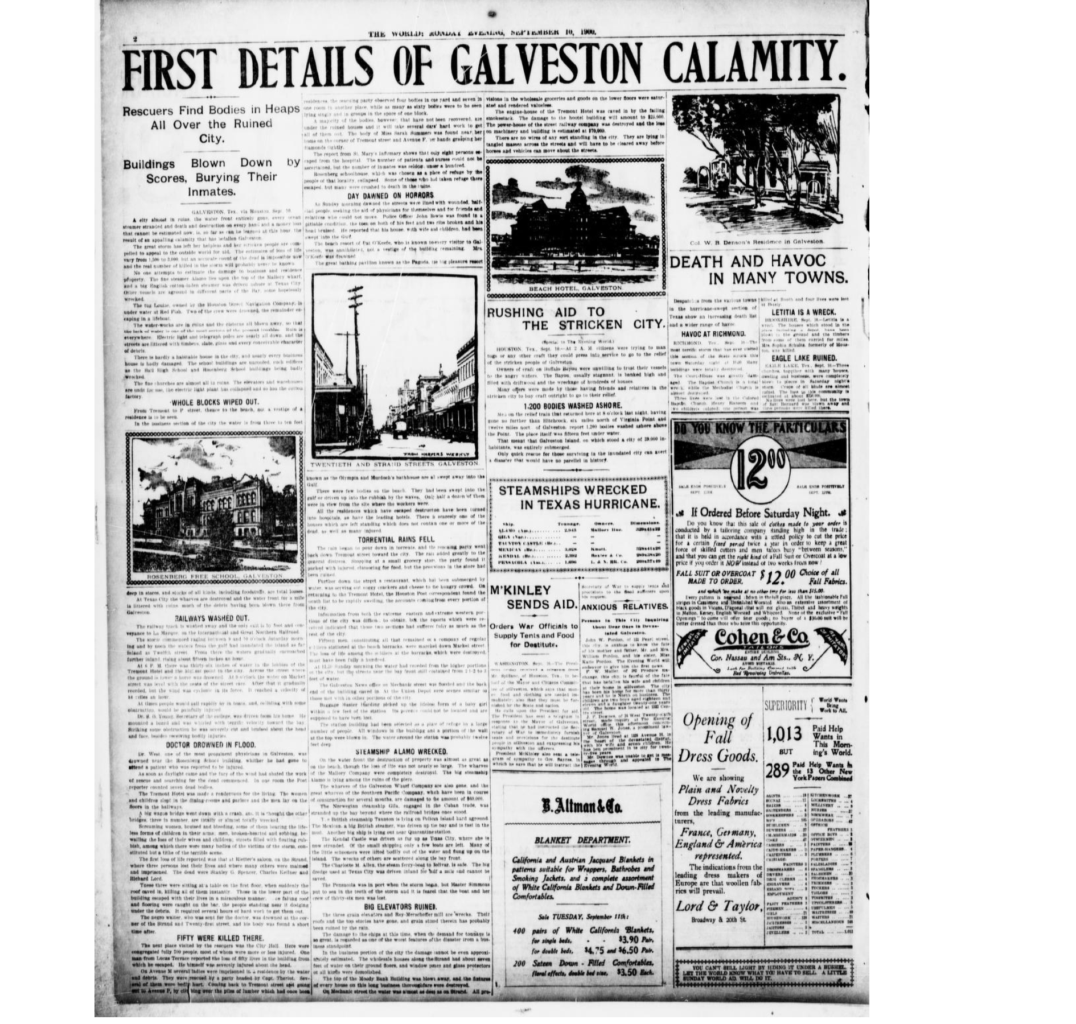
The Evening World. September 10, 1900

Slide 21
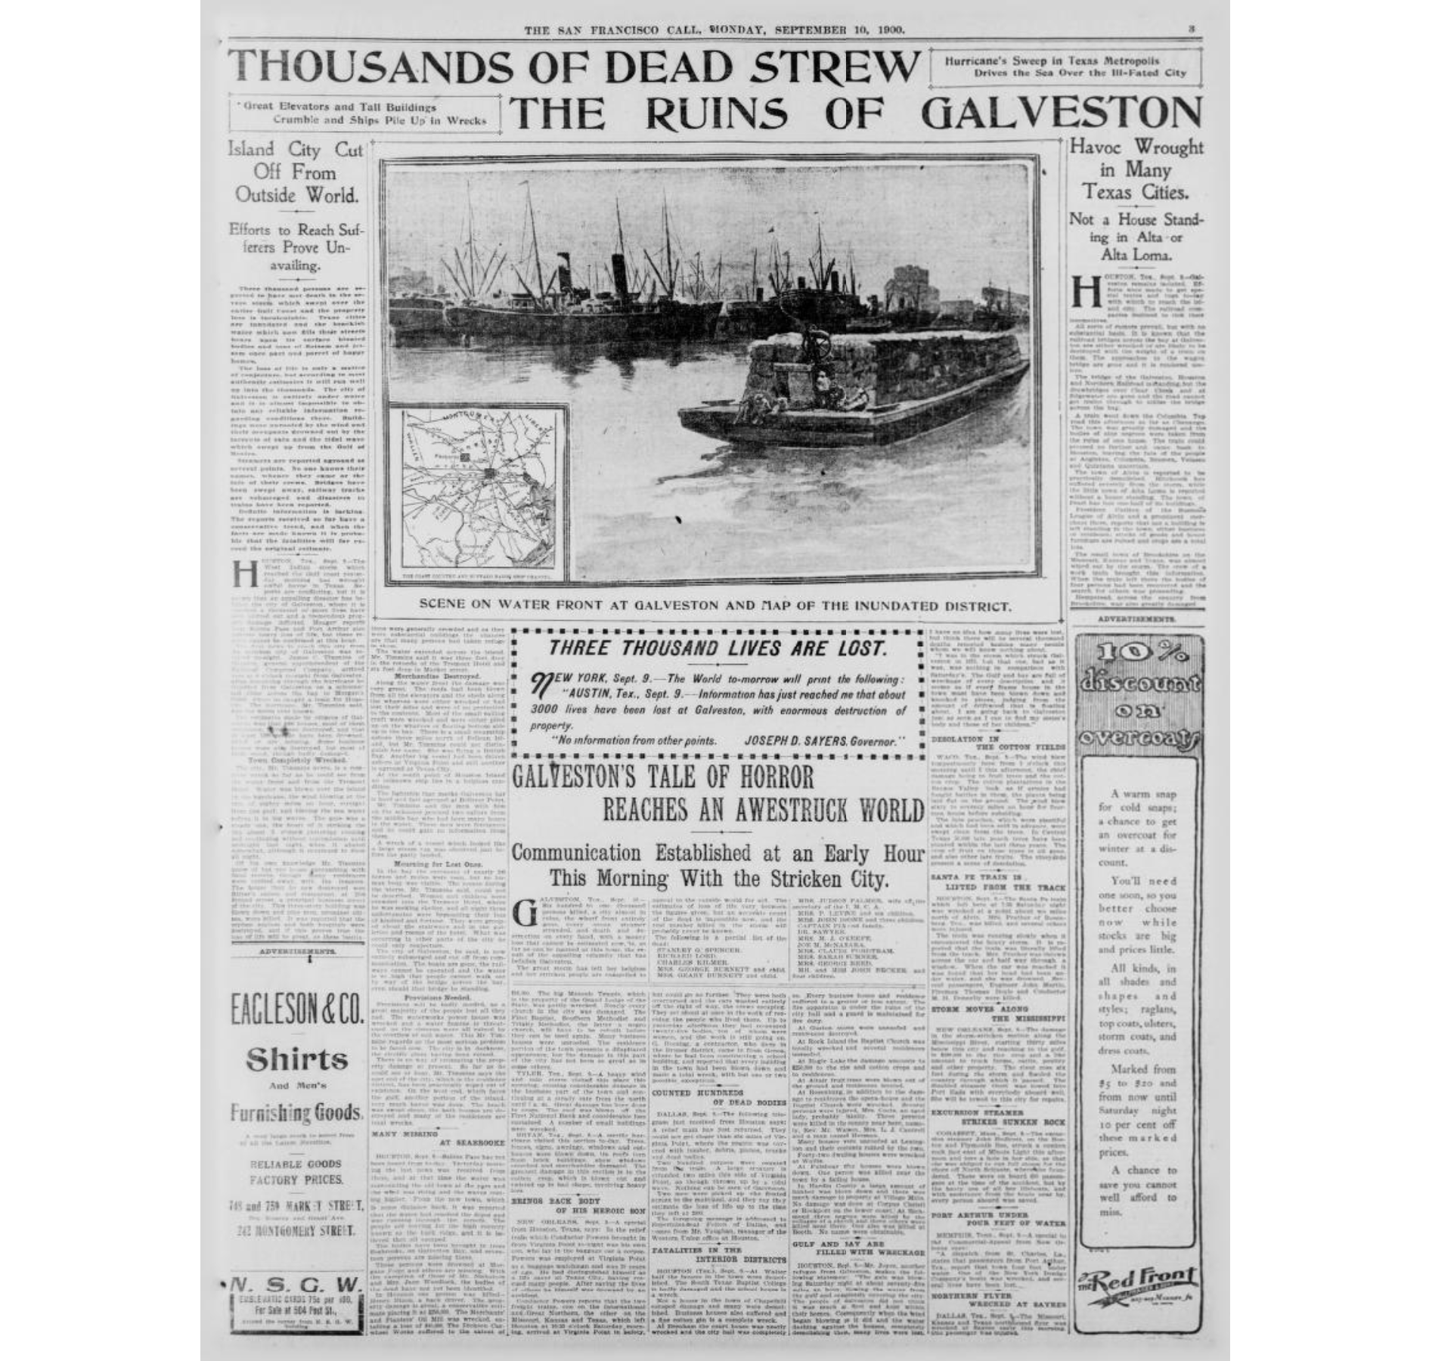
The San Francisco Call. September 10, 1900

Slide 22
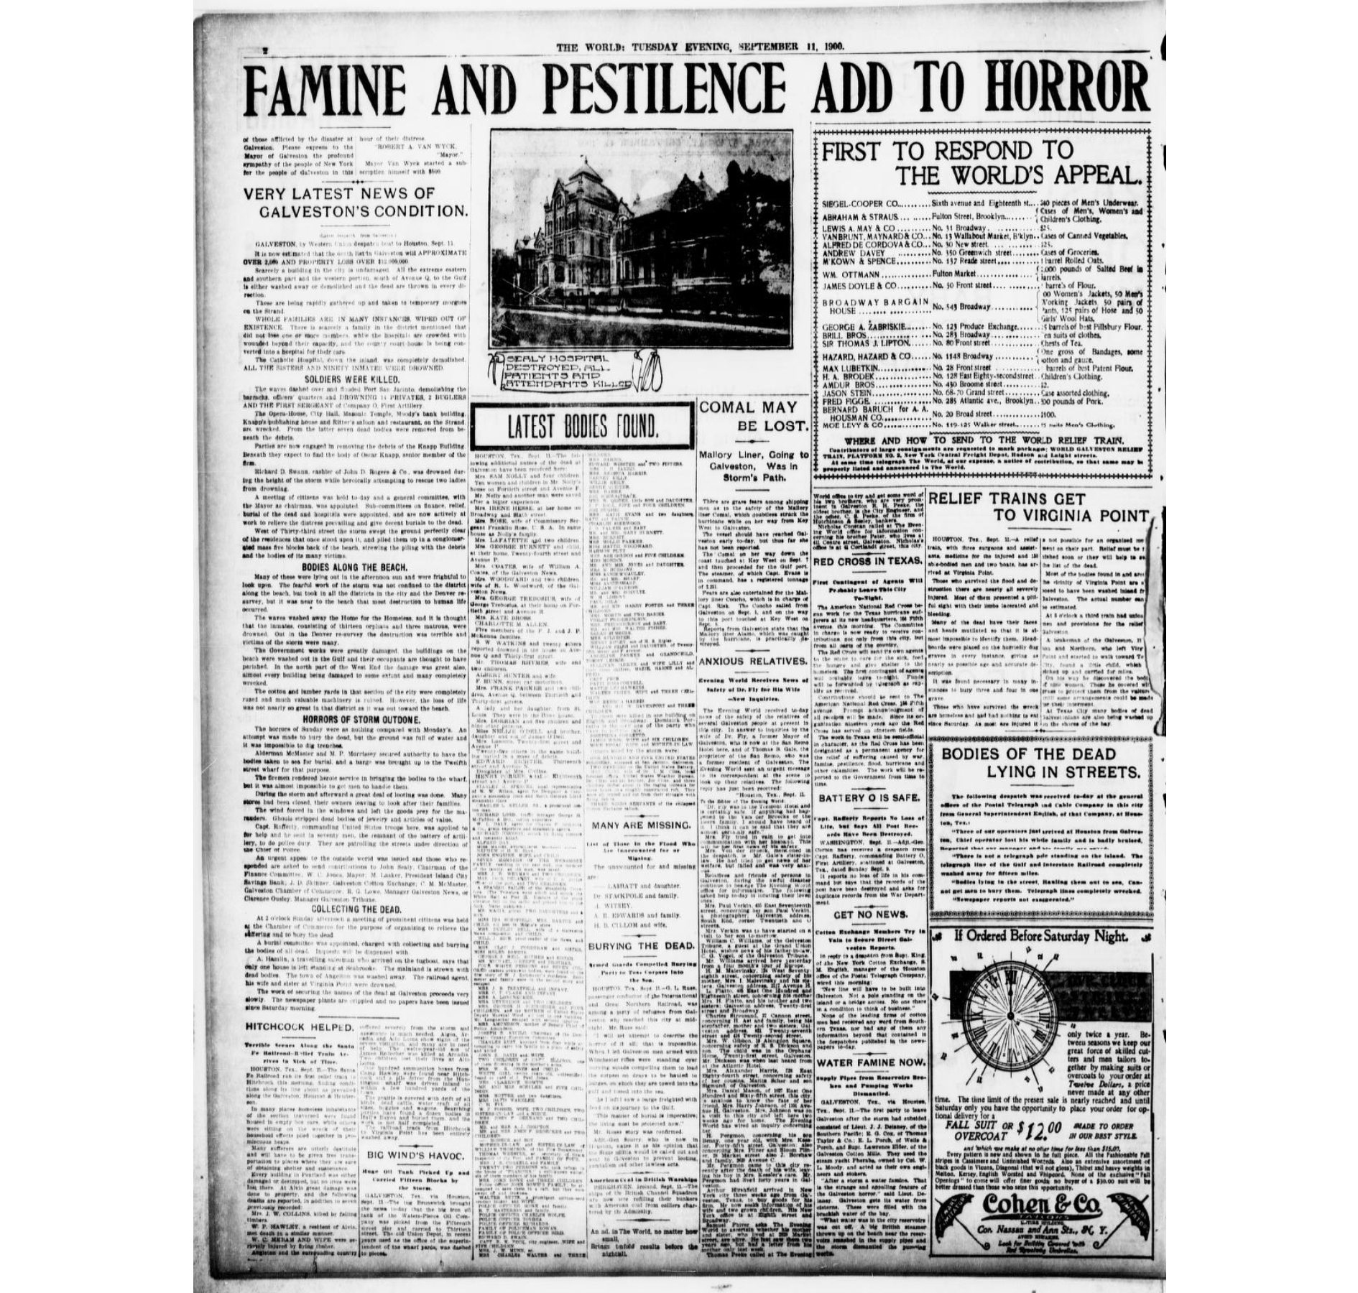
The Evening World. September 11, 1900

Slide 23
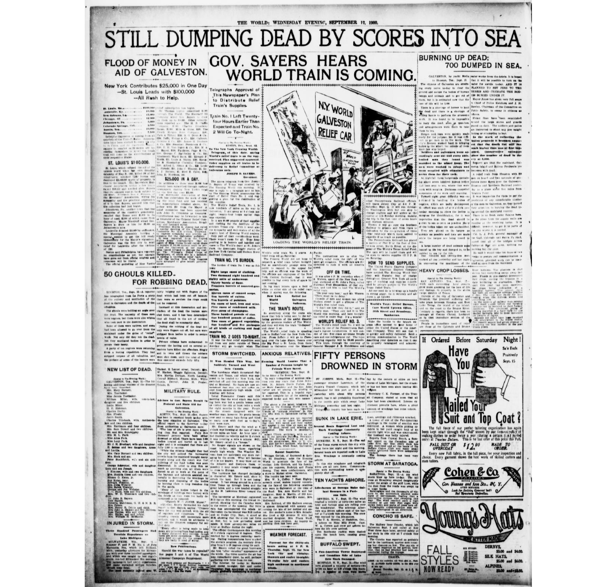
The Evening World. September 12, 1900

Slide 24
Heat waves, 19th Century

Slide 26
Communicate clearly

Slide 28
Think in modules and interfaces

Slide 30
Capture attention

